Slide 1

Medical Overview
CHAPTER 15

Slide 2
National EMS Education Standard Competencies (1 of 3)
Medicine
Applies fundamental knowledge to provide basic emergency care and transportation based on assessment findings for an acutely ill patient.
Notes:
National EMS Education Standard Competencies
Medicine
Applies fundamental knowledge to provide basic emergency care and transportation based on assessment findings for an acutely ill patient.

Slide 3
National EMS Education Standard Competencies (2 of 3)
Medical Overview
Assessment and management of a
  Medical complaint
Pathophysiology, assessment, and management of medical complaints to include
  Transport mode
  Destination decisions
Notes:
National EMS Education Standard Competencies
Medical Overview
Assessment and management of a
• Medical complaint
Pathophysiology, assessment, and management of medical complaints to include
• Transport mode
• Destination decisions

Slide 4
National EMS Education Standard Competencies (3 of 3)
Infectious Diseases
Awareness of
  A patient who may have an infectious disease
Assessment and management of
  A patient who may have an infectious disease
Notes:
National EMS Education Standard Competencies
Infectious Diseases
Awareness of
• A patient who may have an infectious disease
Assessment and management of
• A patient who may have an infectious disease

Slide 5
Introduction
Patients who need EMS assistance generally have experienced a medical emergency, a trauma emergency, or both.
  Trauma emergencies involve injuries resulting from physical forces applied to the body.
  Medical emergencies involve illnesses or conditions caused by disease.
Notes:
Lecture Outline
I. Introduction
A. Patients who need EMS assistance generally have experienced a medical emergency, a trauma emergency, or both.
1. Trauma emergencies involve injuries resulting from physical forces applied to the body.
2. Medical emergencies involve illnesses or conditions caused by disease.
3. It is important to remember that patients may have a combination of medical and trauma conditions.

Slide 6
Types of Medical Emergencies (1 of 4)
Respiratory emergencies: patients have trouble breathing or the amount of oxygen supplied to the tissues is inadequate
Cardiovascular emergencies: caused by conditions affecting the circulatory system
Neurologic emergencies: involve the brain
Gastrointestinal conditions: appendicitis, diverticulitis, pancreatitis, and many others
Notes:
Lecture Outline
B. Types of medical emergencies
1. Respiratory emergencies occur when patients have trouble breathing or when the amount of oxygen supplied to the tissues is inadequate.
2. Cardiovascular emergencies are caused by conditions affecting the circulatory system.
3. Neurologic emergencies involve the brain.
4. Gastrointestinal conditions include appendicitis, diverticulitis, pancreatitis, and many others.

Slide 7
Types of Medical Emergencies (2 of 4)
Urologic emergency: kidney stones
Endocrine emergencies: most commonly caused by complications of diabetes mellitus
Hematologic emergencies: may be the result of sickle cell disease or blood-clotting disorders
Notes:
Lecture Outline
A urologic emergency can involve kidney stones.
The most common endocrine emergencies are caused by complications of diabetes mellitus.
Hematologic emergencies may be the result of sickle cell disease or various types of blood-clotting disorders such as hemophilia.

Slide 8
Types of Medical Emergencies (3 of 4)
Immunologic emergencies: involve the body’s response to foreign substances
Toxicologic emergencies: include poisoning and substance abuse
Some medical emergencies are caused by psychological or behavioral problems.
Gynecologic emergencies: involve female reproductive organs
Notes:
Lecture Outline
8. Immunologic emergencies involve the body’s response to foreign substances.
9. Toxicologic emergencies, including poisoning and substance abuse, result in other types of medical emergencies.
10. Some medical emergencies are caused by psychological or behavioral problems, and may be especially difficult to deal with because patients often do not present with typical signs and symptoms.
11. Gynecologic conditions are a special category of medical emergencies that involve the female reproductive organs.

Slide 9
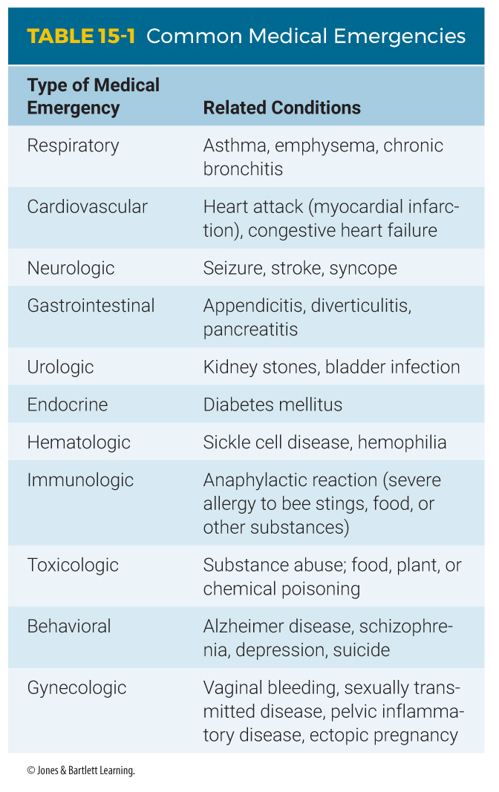
Types of Medical Emergencies (4 of 4)
Notes:
This table shows types of common medical emergencies.

Slide 10
Patient Assessment (1 of 3)
Similar to the assessment of the trauma patient, but with a different focus
Focused on:
  Nature of illness (NOI)
  Symptoms
  Chief complaint
Notes:
Lecture Outline
II. Patient Assessment
A. Assessment of the medical patient is similar to assessment of the trauma patient, but with a different focus.
1. Medical patient assessment is focused on:
a. Nature of illness (NOI)
b. Symptoms
c. Chief complaint

Slide 11
Patient Assessment (2 of 3)
Establish an accurate medical history.
Use dispatch information to guide initial response.
Do not get locked into a preconceived idea of the patient’s condition.
Notes:
Lecture Outline
2. Establish an accurate medical history.
3. Use dispatch information to guide your initial response, but do not get locked into a preconceived idea of the patient’s condition.
a. Injuries may distract from the underlying condition.
b. Tunnel vision occurs when you become focused on one aspect of the patient’s condition and exclude all others, which may cause you to miss an important injury or illness.

Slide 12
Patient Assessment (3 of 3)
Assessment may be difficult with uncooperative or hostile patients.
  Maintain a professional, calm, nonjudgmental demeanor.
  Refrain from labeling patients.
  A frequent caller may have a different complaint this time.
Notes:
Lecture Outline
4. Assessment may be difficult with uncooperative or hostile patients.
a. Maintain a professional, calm, nonjudgmental demeanor at all times.
b. Refrain from labeling patients and displaying personal biases.
c. A frequent caller may have a different complaint this time.

Slide 13
Scene Size-up
Scene safety
  Make certain the scene is safe.
  Use standard precautions.
  Determine the number of patients and whether you need additional help.
Nature of illness (NOI)
  Index of suspicion: your awareness of potentially serious underlying injuries or illness
Notes:
Lecture Outline
B. Scene size-up
1. Scene safety
a. Ensure the scene is safe for you, your crew, and your patient.
b. Use standard precautions and determine the number of patients and whether you need additional help.
2. Determine the NOI.
a. The index of suspicion is your awareness and concern for potentially serious underlying and unseen injuries or illness.
b. Initiate spinal immobilization if indicated.

Slide 14
Primary Assessment (1 of 5)
Develop a general impression.
  Perform a rapid examination of the patient.
  Quickly determine the patient’s level of consciousness.
Notes:
Lecture Outline
C. Primary assessment
1. Develop a general impression.
a. Perform a rapid examination of the patient to identify life threats.
b. Quickly determine the patient’s level of consciousness using the AVPU scale.

Slide 15
Primary Assessment (2 of 5)
Airway and breathing
  In conscious patients, ensure the airway is open and they are breathing adequately.
  Check respiratory rate, depth, and quality.
  Consider applying oxygen if breathing has been affected.
  For unconscious patients, make sure to open the airway using the proper technique.
Notes:
Lecture Outline
2. Airway and breathing
a. In conscious patients, ensure the airway is open and they are breathing adequately.
b. Check the respiratory rate, depth, and quality.
c. Consider applying oxygen if breathing has been affected.
d. For unconscious patients, make sure to open the airway using the proper technique, and take several seconds to evaluate their breathing.

Slide 16
Primary Assessment (3 of 5)
Apply oxygen to patients:
  In shock
  With difficulty breathing
  When low oxygen saturations are measured
Unconscious patients may need airway adjuncts and ventilatory assistance with a bag-mask device.
Notes:
Lecture Outline
e. Apply oxygen to patients if necessary
i. In shock
ii. With difficulty breathing
iii. When low oxygen saturations are measured (SpO₂ less than 94%)
f. Unconscious patients may need airway adjuncts and ventilatory assistance with a bag-mask device.

Slide 17
Primary Assessment (4 of 5)
Circulation
  In a conscious patient by check the radial pulse and observe the patient’s skin color, temperature, and condition.
  For unconscious patients, assess circulation at the carotid artery.
Notes:
Lecture Outline
3. Circulation
a. In a conscious patient by check the radial pulse and observe the patient’s skin color, temperature, and condition.
b. For unconscious patients, assess the circulation at the carotid artery.

Slide 18
Primary Assessment (5 of 5)
Transport decision
  Patients in need of rapid transport:
    Unconscious or have an altered mental status
    Airway or breathing problems
    Obvious circulation problems such as severe bleeding or signs of shock
Notes:
Lecture Outline
4. Transport decision
a. The following patients should be considered in serious condition and in need of rapid transport:
i. Patients who are unconscious or who have an altered mental status
ii. Patients with airway or breathing problems
iii. Patients with obvious circulation problems such as severe bleeding or signs of shock
b. If the patient does not meet the criteria for rapid transport, continue your assessment on scene and prepare for transport when you have completed the assessment and treatment.

Slide 19
History Taking (1 of 2)
Determine what the problem is or what may be causing the problem.
Gather a thorough history.
For an unconscious patient, survey the scene for medication containers or medical devices.
Notes:
Lecture Outline
D. History taking
1. Determine what the problem is or what may be causing the problem.
Gather a thorough history
Investigate the NOI by inquiring about the chief complaint.
c. For an unconscious patient, survey the scene for medication containers or medical devices.

Slide 20
History Taking (2 of 2)
Obtain a SAMPLE history and use the OPQRST mnemonic.
Record any allergies, medical conditions, and medications.
Some patients take numerous medications; take the medications with you to the hospital.
Notes:
Lecture Outline
2. Obtain a SAMPLE history and to ask questions about the patient’s chief complaint using the OPQRST mnemonic.
3. Record any allergies, medical conditions, and medications.
4. Some patients take numerous medications; take the medications with you to the hospital and list them in your report.

Slide 21
Secondary Assessment (1 of 3)
May occur on scene or en route to the ED
  In some cases you may not have time.
Physical examination
  All conscious patients should undergo a limited or detailed physical examination.
  For unconscious patients, always perform a secondary assessment of the entire body or head-to-toe examination.
Notes:
Lecture Outline
E. Secondary assessment
1. The secondary assessment may occur on scene or en route to the ED.
a. In some cases, you may not have time to conduct a secondary assessment.
2. Physical examinations
a. All conscious patients should undergo a limited or detailed physical examination based on their chief complaint.
b. For unconscious patients, you should always perform a secondary assessment of the entire body or head-to-toe examination to obtain clues to assess the problem.
c. A full body assessment should help you obtain clues and should be performed quickly so it does not delay transport.

Slide 22
Secondary Assessment (2 of 3)
Physical examination (cont’d)
  Examine the head, scalp, and face.
  Examine the neck closely.
  Assess the chest and abdomen.
  Palpate the legs and arms.
  Examine the patient’s back.
Notes:
Lecture Outline
d. If the patient’s condition warrants the secondary assessment:
i. Examine the head, scalp, and face.
ii. Examine the neck closely.
iii. Assess the chest and abdomen.
iv. Palpate the legs and arms.
v. Examine the patient’s back.
e. Treatment will depend on the condition(s) found and your local protocols.

Slide 23
Secondary Assessment (3 of 3)
Vital signs
  Assess the pulse for rate, quality, and regularity.
  Identify the rate, quality, and regularity of the respirations.
  Obtain an initial blood pressure.
  Consider obtaining a blood glucose level and a pulse oximetry reading.
Notes:
Lecture Outline
3. Vital signs
a. Assess the pulse for rate, quality, and regularity at the most appropriate site.
b. Identify the rate, quality, and regularity of the respirations and any difficulties that may be apparent.
c. Obtain an initial blood pressure, measuring both systolic and diastolic pressures.
d. Consider using the automatic blood pressure cuff for future assessments at regular intervals.
e. Consider obtaining a blood glucose level and a pulse oximetry reading.

Slide 24
Reassessment
Performed once the assessment and treatment have been completed
Begins and continues throughout transport
  Consider the need for ALS backup.
Reassess interventions.
Document any developed changes.
Notes:
Lecture Outline
E. Reassessment
1. Once the assessment and treatment have been completed, reassessment should begin and continue throughout transport.
a. Repeat the primary assessment and reassess the chief complaint.
b. Consider the need for ALS backup.
c. Repeat your physical examination to identify and treat changes in the patient’s condition.
d. Obtain vital signs every 5 minutes for unstable patients and every 15 minutes for stable patients.
2. Review all treatments that have been performed.
3. Document any changes that have developed as a result of the treatments, and, if needed, adjust any of the treatments accordingly.

Slide 25
Management: Transport and Destination (1 of 6)
Most medical emergencies require a level of treatment beyond that available in the prehospital setting.
  May require advanced testing available in a hospital
  May be beyond the scope of the EMT to administer medications to a patient
  EMTs can use the AED.
Notes:
Lecture Outline
III. Management: Transport and Destination
A. Most medical emergencies require a level of treatment beyond that available in the prehospital setting.
1. May require advanced testing available in a hospital
2. It may be beyond the scope of an EMT to administer medications to a patient.
a. Any administration of medication by an EMT requires direct permission from medical control.
3. EMTs can use an automated external defibrillator (AED) on a patient who is pulseless and apneic.

Slide 26
Management: Transport and Destination (2 of 6)
Scene time
  May be longer for medical patients than for trauma patients
  Gather as much information as possible to transmit to the ED.
  Critical patients always need rapid transport.
Notes:
Lecture Outline
B. Scene time
1. Scene time may be longer for medical patients than for trauma patients.
2. Gather as much information as possible to transmit to the ED.
3. Critical patients always need rapid transport. They include patients:
a. With altered mental status
b. With airway or breathing difficulties
c. With any sign of circulatory compromise
d. Who are very old or very young

Slide 27
Management: Transport and Destination (3 of 6)
Type of transport
  Life-threatening condition: lights and siren
  Non–life-threatening condition: consider nonemergency transport.
Modes of transport ultimately come in one of two categories: ground or air.
Notes:
Lecture Outline
C. Type of transport
1. If a life-threatening condition exists, the transportation should include lights and siren.
2. If the patient is not critical, consider nonemergency transport.
3. Modes of transport ultimately come in one of two categories: ground or air.

Slide 28
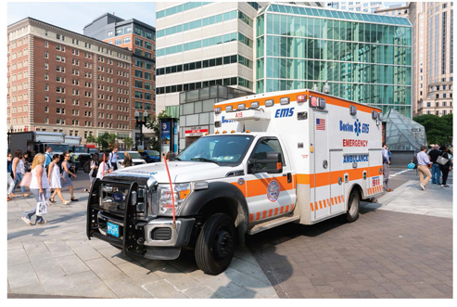
Management: Transport and Destination (4 of 6)
Ground transport EMS units are generally staffed by EMTs and paramedics.
FIGURE 15-4 Ground transport.
© 2p2play/Shutterstock.
Notes:
Lecture Outline
a. Ground transport EMS units are generally staffed by EMTs and paramedics.

Slide 29
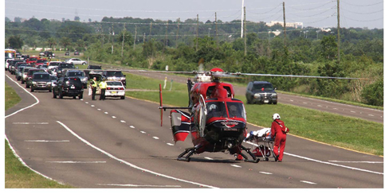
Management: Transport and Destination (5 of 6)
Air transport EMS units are generally staffed by critical care transport professionals and paramedics.
FIGURE 15-5 Air transport.
LindaCharlton/iStock.
Notes:
Lecture Outline
b. Air transport EMS units are generally staffed by critical care transport professionals and paramedics.

Slide 30
Management: Transport and Destination (6 of 6)
Destination selection
  Generally, the closest hospital should be your destination.
  Sometimes the patient will benefit from going to another hospital capable of handling his or her particular condition.
Notes:
Lecture Outline
D. Destination selection
1. Generally, the closest hospital should be your destination.
2. Sometimes the patient will benefit from going to another hospital that is capable of handling his or her particular condition.

Slide 31
Infectious Diseases (1 of 3)
General assessment principles:
  Approach like any other medical patient.
  Perform scene size-up, take standard precautions, and complete primary assessment.
  Gather patient history using OPQRST to elaborate on the patient’s chief complaint.
Notes:
Lecture Outline
IV. Infectious Diseases
A. General assessment principles
1. Approach the patient with an infectious disease like any other medical patient.
2. Perform scene size-up, take standard precautions, and complete primary assessment.
3. Gather patient history using OPQRST to elaborate on the patient’s chief complaint.

Slide 32
Infectious Diseases (2 of 3)
General assessment principles (cont’d):
  Obtain a SAMPLE history and a set of baseline vital signs.
  Ask whether the patient has recently traveled or has come in contact with someone who has traveled.
Notes:
Lecture Outline
4. Obtain a SAMPLE history and a set of baseline vital signs; pay particular attention to medications and the events leading up to today’s problem.
5. Ask whether the patient has recently traveled or has come in contact with someone who has traveled.

Slide 33
Infectious Diseases (3 of 3)
General management principles:
  Focus on any life-threatening conditions identified in the primary assessment.
  Be empathetic.
  Place the patient in the position of comfort on the stretcher and keep them warm.
  Use standard precautions.
Notes:
Lecture Outline
B. General management principles
1. Focus on any life-threatening conditions identified in the primary assessment.
2. Be empathetic.
3. Place the patient in the position of comfort on the stretcher and keep them warm.
4. Use standard precautions.
a. Always follow your agency’s exposure control plan in cleaning equipment; and properly discard any disposable supplies and wash linens.

Slide 34
Epidemic and Pandemic Considerations
Epidemic: new cases of a disease in a human population substantially exceed what is expected.
Pandemic: a disease outbreak that occurs on a global scale
Notes:
Lecture Outline
C. Epidemic and pandemic considerations
1. Epidemic: when new cases of a disease in a human population substantially exceed what is expected
2. Pandemic: a disease outbreak that occurs on a global scale.

Slide 35
Influenza (1 of 2)
Those with chronic medical conditions, compromised immune systems, and the very young and the very old are most susceptible to complications of influenza.
Transmitted by direct contact with nasal secretions and aerosolized droplets from coughing and sneezing by infected people.
Notes:
Lecture Outline
V. Common or Serious Communicable Diseases
A. Influenza
1. Those with chronic medical conditions, compromised immune systems, and the very young and the very old are most susceptible to complications of influenza.
2. Transmitted by direct contact with nasal secretions and aerosolized droplets from coughing and sneezing by infected people.

Slide 36
Influenza (2 of 2)
For diseases that can be passed by the respiratory route:
  Always wear PPE (gloves, eye protection, and HEPA respirator or N95 mask).
  Place a surgical mask on patients with suspected or confirmed respiratory disease.
Annual influenza immunization is important for EMS personnel to protect providers and patients.
Notes:
Lecture Outline
3. For diseases that can be passed by the respiratory route:
a. Always wear PPE (gloves, eye protection, and a HEPA respirator or N95 mask at a minimum).
b. Wash hands frequently
c. Place a surgical mask on patients with suspected or confirmed respiratory disease
d. Wear HEPA respirator or N95 mask during aerosol-generating procedures, such as suctioning of airway secretions, performing CPR, or assisting with endotracheal intubation.
4. Annual influenza immunization is important for EMS personnel to protect providers and patients.

Slide 37
Herpes Simplex
Common virus strain carried by humans
Symptomatic infections cause vesicles that appear on the lips or genitals.
Can cause more serious illnesses in susceptible patients
Primary mode of infection is through close personal contact.
Notes:
Lecture Outline
B. Herpes simplex
1. This is a common virus strain carried by humans.
2. Symptomatic infections cause eruptions of tiny fluid filled blisters called vesicles that appear on the lips or genitals.
3. Can cause more serious illnesses like pneumonia and meningitis in the very young, very old, and immunocompromised patients.
4. The primary mode of infection is through close personal contact, so standard precautions are generally sufficient to prevent spread to or from health care workers.

Slide 38
HIV Infection (1 of 2)
EMTs face a risk of exposure.
No vaccine yet exists.
AIDS can still be fatal; however, with treatment, patients can expect a near-normal lifespan.
Not easily transmitted in the work setting
  Your risk of infection is limited to exposure to an infected patient’s blood or body fluids.
Notes:
Lecture Outline
C. HIV infection
1. EMTs face a risk of exposure to the virus that causes AIDS on a regular basis.
2. AIDS can still be fatal; however, with treatment, patients can expect a near-normal lifespan.
3. HIV infection is a potential hazard only when deposited on mucous membranes or directly into the bloodstream.
a. It is not easily transmitted in the work setting.
b. Your risk of infection is limited to exposure to an infected patient’s blood and body fluids.

Slide 39
HIV Infection (2 of 2)
Many patients with HIV show no symptoms.
  Always wear the proper type of gloves.
  Take great care in handling and disposing of needles.
  Cover any open wounds.
If you think a patient’s blood or secretions may have entered your system, seek medical advice and notify your infectious disease officer.
Notes:
Lecture Outline
4. Many patients with human immunodeficiency virus (HIV) show no symptoms.
a. Always wear the proper type of gloves.
b. Take great care in handling and properly disposing of needles and other sharp objects.
Cover any open wounds that you have whenever you are on the job
If you think that a patient’s blood or secretions may have entered your system, seek medical advice as soon as possible and notify your infectious disease officer.

Slide 40
Hepatitis (1 of 2)
Inflammation (and often infection) of the liver
Can be caused by viruses and toxins
There is no sure way to tell which hepatitis patients are contagious.
Vaccination with hepatitis B vaccine is highly recommended for EMTs.
Notes:
Lecture Outline
D. Hepatitis
1. Inflammation (and often infection) of the liver. Dele
2. Can be caused by a number of different viruses and toxins
3. There is no sure way to tell which hepatitis patients are contagious.
4. Hepatitis A can be transmitted only from a patient who has an acute infection, whereas hepatitis B and hepatitis C can be transmitted from long-term carriers who have no signs of illness.
a. A carrier is a person (or animal) in whom an infectious organism has taken up permanent residence and may or may not cause an active disease.
b. Hepatitis A is transmitted orally through oral or fecal contamination.
c. Hepatitis B is far more contagious than HIV.
d. Vaccination with hepatitis B vaccine is highly recommended for EMTs.

Slide 41
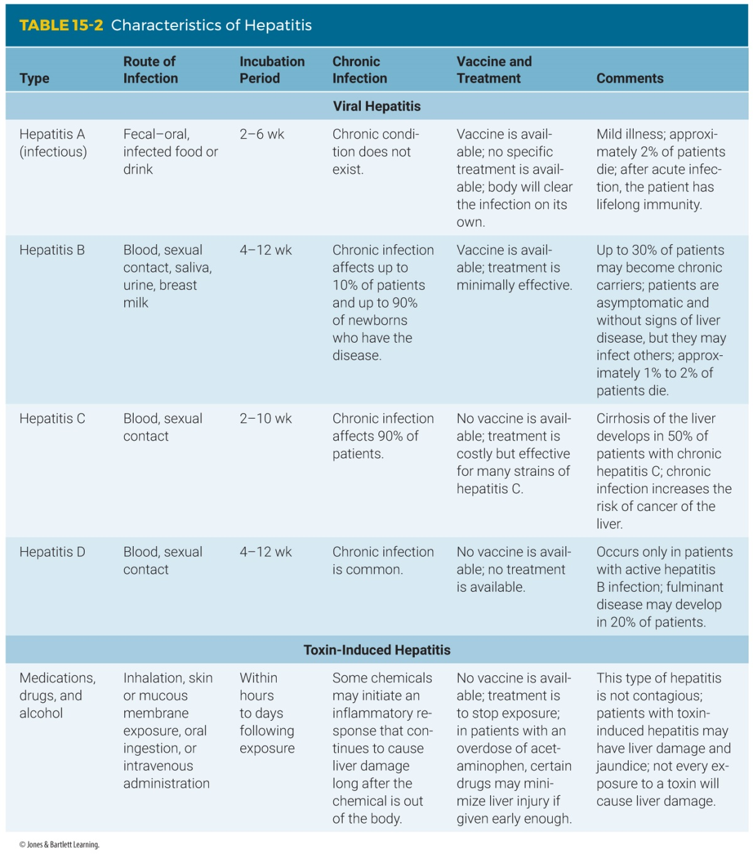
Hepatitis (2 of 2)
Notes:
This table shows the characteristics of different types of hepatitis.

Slide 42
Meningitis
Inflammation of the meningeal coverings of the brain and spinal cord
Most forms of meningitis are not contagious.
Take standard precautions.
Can be treated at the ED with antibiotics.
After treating a meningitis patient, contact your employer health representative.
Notes:
Lecture Outline
E. Meningitis
1. Inflammation of the meningeal coverings of the brain and spinal cord
2. Most forms of meningitis are not contagious.
a. One form, meningococcal meningitis, is highly contagious.
3. Take standard precautions.
a. Gloves and a mask will go a long way to prevent the patient’s secretions from getting into your nose and mouth.
b. Vaccines are rarely used.
c. Meningitis can be treated at the ED with antibiotics.
4. After treating a patient with meningitis, contact your employer health representative.

Slide 43
Tuberculosis (1 of 2)
Most infected patients are well most of the time.
Chronic mycobacterial disease that usually strikes the lungs
Patients who pose the highest risk almost always have a cough.
  N95 or HEPA mask is required to stop droplet nuclei.
Notes:
Lecture Outline
F. Tuberculosis
1. Most infected patients are well most of the time.
2. A chronic mycobacterial disease that usually strikes the lungs
3. Disease that occurs shortly after infection is called primary tuberculosis.
Reactive tuberculosis is common and can be much more difficult to treat.
4. Patients who pose the highest risk almost always have a cough.
a. Consider respiratory tuberculosis to be the only contagious form because it is the only one that is spread by airborne transmission.
b. Droplet nuclei: the remnants of the droplets produced by coughing after the excess water has evaporated
c. N95 or HEPA mask is required to stop droplet nuclei.

Slide 44
Tuberculosis (2 of 2)
Absolute protection from the tubercle bacillus does not exist.
  One-third of the world’s population is infected with tuberculosis.
Have tuberculin skin tests regularly.
  Preventive therapy is almost 100% effective.
Notes:
Lecture Outline
5. Absolute protection from infection with the tubercle bacillus does not exist.
a. According to the Centers for Disease Control and Prevention, one-third of the world’s population is infected with tuberculosis.
b. The mechanism of transmission is not very efficient.
6. Have tuberculin skin tests regularly.
a. If the infection is found before you become ill, preventive therapy is almost 100% effective.

Slide 45
Whooping Cough
Also called pertussis
Mostly affects children younger than 6 years
Symptoms include fever and a “whoop” sound that occurs when inhaling after a coughing attack.
The best way to prevent exposure is to be vaccinated.
  Place a mask on the patient and yourself.
Notes:
Lecture Outline
G. Whooping cough
1. Also called pertussis, whooping cough is an airborne disease caused by bacteria that mostly affects children younger than 6 years.
2. Symptoms include fever and a “whoop” sound that occurs when inhaling after a coughing attack.
3. The best way to prevent exposure is to be vaccinated with the DPT or TDaP; you can also place a mask on the patient and yourself.

Slide 46
Methicillin-Resistant Staphylococcus aureus (MRSA) (1 of 2)
MRSA is a bacterium that causes infections.
Resistant to many antibiotics
In health care settings, MRSA is transmitted from patient to patient by health care providers’ unwashed hands.
Notes:
Lecture Outline
H. Methicillin-resistant Staphylococcus aureus (MRSA)
1. MRSA is a bacterium that causes infections and is resistant to many antibiotics.
2. In health care settings, MRSA is transmitted from patient to patient by the unwashed hands of health care providers.

Slide 47
Methicillin-Resistant Staphylococcus aureus (MRSA) (2 of 2)
Factors that increase the risk of MRSA:
  Antibiotic therapy
  Prolonged hospital stays
  A stay in an intensive care or burn unit
  Exposure to an infected patient
MRSA results in soft-tissue infections.
Notes:
Lecture Outline
3. Factors that increase the risk for developing MRSA include:
a. Antibiotic therapy
b. Prolonged hospital stays
c. A stay in an intensive care or burn unit
d. Exposure to an infected patient
The incubation period for MRSA appears to be between 5 and 45 days
MRSA results in soft-tissue infections.
a. Signs and symptoms: localized skin abscesses and sepsis in older patients

Slide 48
Global Health Issues (1 of 3)
COVID-19
  Originated in Wuhan, Hubei Province, China
  Quickly spread, infecting millions, killing hundreds of thousands
  Controlling the virus: social distancing
  Symptoms include fever, cough, shortness of breath that appear 2–14 days after exposure
  CDC website (www.cdc.gov)
Notes:
Lecture Outline
I. Global health issues
1. 2019 Novel coronavirus (COVID-19)
a. Originated in Wuhan, Hubei Province, China
b. Quickly spread, infecting millions and killing hundreds of thousands
c. Controlling the virus: social distancing
d. Symptoms include fever, cough, shortness of breath that appear 2–14 days after exposure to infected person
e. For current updates on COVID-19, use the CDC website (www.cdc.gov).

Slide 49
Global Health Issues (2 of 3)
MERS-CoV (Middle East respiratory syndrome coronavirus)
  First human case discovered in 2012 in Saudi Arabia
  No cure or vaccines for this virus at present
  Place a surgical mask on the patient if MERS-CoV is suspected.
Notes:
Lecture Outline
1. MERS-CoV (Middle East respiratory syndrome coronavirus)
a. First human case of MERS-CoV discovered in 2012 in Saudi Arabia
i. Most human infections found in the Middle East
ii. Cases of MERS-CoV have been found in Europe and the United States.
b. If you suspect MERS-CoV, place a surgical mask on the patient and notify the receiving facility.

Slide 50
Global Health Issues (3 of 3)
Ebola
  2014 outbreak of the Ebola virus in West Africa
  Incubation period: 6 to 12 days after exposure
  Symptoms may not appear for as long as 21 days after infection.
  Fatality rate can be as high as 70% if treatment in an ICU is not initiated promptly.
Notes:
Lecture Outline
2. Ebola
a. In 2014, an outbreak of the Ebola virus in West Africa, which spread when infected people traveled to other countries, caused international concern.
Incubation period is 6 to 12 days after exposure
Symptoms may not appear for as long as 21 days after infection.
d. Fatality rate can be as high as 70% if treatment in an ICU is not initiated promptly.
e. If you suspect Ebola, place a surgical mask the patient, follow PPE precautions as outlined by local protocols and the CDC, and notify the receiving facility.

Slide 51
Travel Medicine (1 of 2)
Be aware of travel-acquired infections when assessing a patient who was recently outside of the United States.
Patients can present with a variety of symptoms.
When you encounter an ill patient with a recent travel history, place a mask on the patient and gather as much information as possible.
Notes:
Lecture Outline
J. Travel Medicine
1. You must be aware of travel-acquired infections when assessing a patient who was recently outside of the United States.
2. Patients can present with a variety of symptoms, including fever, cough, vomiting, bloody diarrhea, body aches, and rashes.
3. When you encounter an ill patient with a recent travel history, place a mask on the patient and gather as much information as possible.

Slide 52
Travel Medicine (2 of 2)
Important questions to ask include:
  Where did you recently travel?
  Did you receive any vaccinations before your trip?
  Were you exposed to any infectious diseases?
  Is there anyone else in your travel party who is sick?
  What types of foods did you eat?
  What was your source of drinking water?
Notes:
Lecture Outline
4. Important questions to ask include:
a. Where did you recently travel?
b. Did you receive any vaccinations before your trip?
c. Were you exposed to any infectious diseases?
d. Is there anyone else in your travel party who is sick?
e. What types of foods did you eat?
f. What was your source of drinking water?
5. If you suspect the patient has a communicable illness, follow appropriate PPE precautions and notify the receiving facility.

Slide 53
Conclusion
Assessment and treatment of medical patients can be challenging and interesting because of the nature of medical conditions.
  The condition of a medical patient may not be as apparent as in a trauma patient and treatment may not be as straightforward.
  Patients sometimes have more than one isolated problem.
Notes:
Lecture Outline
VI. Conclusion
A. The assessment and treatment of medical patients can be challenging and interesting because of the nature of medical conditions.
1. The condition of a medical patient may not be as apparent as in a trauma patient and treatment may not be as straightforward.
2. Delays in an attempt to diagnose a condition can be harmful to the patient.
3. Keep calm, use your patient assessment skills, treat the patient’s symptoms, report to medical control, and transport the patient safely to the emergency department.
4. Be prepared to handle any combination of conditions, including conditions of medical patients who have been involved in trauma.

Slide 54
Review
A seizure patient is having what kind of medical emergency?
  Respiratory
  Cardiovascular
  Neurologic
  Immunologic

Slide 55
Review
Answer: C
Rationale: Neurologic emergencies involve the brain and may be caused by a seizure, stroke, or fainting (syncope).

Slide 56
Review
A seizure patient is having what kind of medical emergency?
  Respiratory
  Rationale: Respiratory emergencies include asthma, emphysema, and chronic bronchitis.
  Cardiovascular
  Rationale: Cardiovascular emergencies include heart attack and congestive heart failure.
  Neurologic
  Rationale: Correct answer
  Immunologic
  Rationale: Allergic reactions are a type of immunologic emergency.

Slide 57
Review
If an injury distracts an EMT from assessing a more serious underlying illness, the EMT has suffered from:
  tunnel vision.
  index of suspicion.
  virulence.
  a trauma emergency.

Slide 58
Review
Answer: A
Rationale: As an EMT, you should use the dispatch information to guide your initial response, but do not get locked into a preconceived idea of the patient’s condition strictly from what the dispatcher tells you. Tunnel vision occurs when you become focused on one aspect of the patient’s condition and exclude all others, which may cause you to miss an important injury or illness.

Slide 59
Review
If an injury distracts an EMT from assessing a more serious underlying illness, the EMT has suffered from:
  tunnel vision.
  Rationale: Correct answer
  index of suspicion.
  Rationale: The index of suspicion is your awareness and concern for potentially serious underlying and unseen injuries or illness.
  virulence.
  Rationale: Virulence is the strength or ability of a pathogen to produce disease.
  a trauma emergency.
  Rationale: Trauma emergencies involve injuries resulting from physical forces applied to the body.

Slide 60
Review
If a “frequent flier” calls 9-1-1 because of a suspected head injury, you should NEVER:
  take the call seriously; don’t waste your time or resources on such a caller.
  perform a primary assessment; he called for a head injury last week, and it wasn’t serious.
  assume you know what the problem is; every case is different, and you don’t want to miss a potentially serious problem.
  treat the patient with respect; he is probably lying.

Slide 61
Review
Answer: C
Rationale: You are obligated as a medical professional to refrain from labeling patients and displaying personal biases. Never assume that you know what the problem is, even when you are treating patients who frequently call for EMS. This attitude could result in missing a serious condition.

Slide 62
Review
If a “frequent flier” calls 9-1-1 because of a suspected head injury, you should NEVER:
  take the call seriously; don’t waste your time or resources on such a caller.
  Rationale: Never assume you know the patient’s problem before you arrive; you should treat every patient equally.
  perform a primary assessment; he called for a head injury last week, and it wasn’t serious.
  Rationale: You should perform a primary assessment on every patient.
  assume you know what the problem is; every case is different, and you don’t want to miss a potentially serious problem.
  Rationale: Correct answer
  treat the patient with respect; he is probably lying.
  Rationale: It is important that you maintain a professional, calm, nonjudgmental demeanor at all times.

Slide 63
Review
If your medical patient is not in critical condition, how long should you spend on scene?
  10 minutes or less
  30 minutes
  2 hours
  However long it takes to gather as much information as possible

Slide 64
Review
Answer: D
Rationale: In many cases, the time on scene may be longer for medical patients than for trauma patients. If the patient is not in critical condition, you should gather as much information as possible from the scene so that you can transmit that information to the physician at the emergency department.

Slide 65
Review
If your medical patient is not in critical condition, how long should you spend on scene?
  10 minutes or less
  Rationale: Critical patients always need rapid transport. The time on scene should be limited to 10 minutes or less.
  30 minutes
  Rationale: There is no set time limit for noncritical patients.
  2 hours
  Rationale: There is no set time limit for noncritical patients.
  However long it takes to gather as much information as possible
  Rationale: Correct answer

Slide 66
Review
Your patient is having respiratory difficulty and is not responding to your treatment. What is the best method of transport?
  Without lights and siren, to the closest hospital
  With lights and siren, to the closest hospital
  Air transport, to a special facility located 30 miles away
  The patient does not need to be transported.

Slide 67
Review
Answer: B
Rationale: Patients with respiratory difficulty generally require high-priority transport, especially if they do not respond to your initial treatment. If a life-threatening condition exists, the transportation should include lights and siren. In this case, it is appropriate to select the closest hospital with an emergency department as your destination.

Slide 68
Review
Your patient is having respiratory difficulty and is not responding to your treatment. What is the best method of transport?
  Without lights and siren, to the closest hospital
  Rationale: Respiratory difficulty is considered a high priority and requires lights and siren en route to the hospital.
  With lights and siren, to the closest hospital
  Rationale: Correct answer
  Air transport, to a special facility located 30 miles away
  Rationale: Respiratory difficulty does not require a special facility; the closest hospital with an ED should suffice.
  The patient does not need to be transported.
  Rationale: All high-priority patients should be rapidly transported.

Slide 69
Review
When assessing a patient with an infectious disease, what is the first action you should perform?
  Size up the scene and take standard precautions.
  Obtain a SAMPLE history.
  Hand the patient off to a paramedic.
  Cover your mouth and nose with your hand.

Slide 70
Review
Answer: A
Rationale: The assessment of a patient suspected to have an infectious disease should be approached much like any other medical patient. First, the scene must be sized up and standard precautions taken. Always show respect for the feelings of the patient, family members, and others at the scene.

Slide 71
Review
When assessing a patient with an infectious disease, what is the first action you should perform?
  Size up the scene and take standard precautions.
  Rationale: Correct answer
  Obtain a SAMPLE history.
  Rationale: You must always ensure your own safety before assessing the patient.
  Hand the patient off to a paramedic.
  Rationale: EMTs are qualified to assess patients with infectious diseases.
  Cover your mouth and nose.
  Rationale: This action is not necessary; most diseases are transmitted via blood or body fluids. Remain calm and be respectful.

Slide 72
Review
Answer: C
Rationale: Cirrhosis of the liver develops in 50% of patients with chronic hepatitis C.

Slide 73
Review
Your patient believes he has hepatitis and is now exhibiting signs of cirrhosis of the liver. He most likely has:
  hepatitis A.
  hepatitis B.
  hepatitis C.
  hepatitis D.

Slide 74
Review
Answer: C
Rationale: Cirrhosis of the liver develops in 50% of patients with chronic hepatitis C.

Slide 75
Review
Your patient believes he has hepatitis and is now exhibiting signs of cirrhosis of the liver. He most likely has:
  hepatitis A.
  Rationale: Cirrhosis of the liver is not an indication.
  hepatitis B.
  Rationale: Cirrhosis of the liver is not an indication.
  hepatitis C.
  Rationale: Correct answer
  hepatitis D.
  Rationale: Cirrhosis of the liver is not an indication.

Slide 76
Review
Your patient is complaining of fever, headache, stiffness of the neck, and red blotches on his skin. He most likely has:
  tuberculosis.
  hepatitis B.
  SARS.
  meningitis.

Slide 77
Review
Answer: D
Rationale: Patients with meningitis will have signs and symptoms such as fever, headache, stiff neck, and altered mental status. Patients with meningococcal meningitis often have red blotches on their skin; however, many patients with forms of meningitis that are not contagious also have red blotches.

Slide 78
Review
Your patient is complaining of fever, headache, stiffness of the neck, and red blotches on his skin. He most likely has:
  tuberculosis.
  Rationale: These are not indications of tuberculosis.
  hepatitis B.
  Rationale: These are not indications of hepatitis B.
  SARS.
  Rationale: These are not indications of SARS.
  meningitis.
  Rationale: Correct answer

Slide 79
Review
What should you do if you are exposed to a patient who is found to have pulmonary tuberculosis?
  Get the BCG vaccine.
  Get a tuberculin skin test.
  Undergo serious therapy.
  No precautions need to be taken.

Slide 80
Review
Answer: B
Rationale: If you are exposed to a patient who is found to have pulmonary tuberculosis, you will be given a tuberculin skin test. This simple skin test determines whether a person has been infected with M. tuberculosis.

Slide 81
Review
What should you do if you are exposed to a patient who is found to have pulmonary tuberculosis?
  Get the BCG vaccine.
  Rationale: The BCG vaccine is only rarely used in the United States. A tuberculin skin test should be sufficient.
  Get a tuberculin skin test.
  Rationale: Correct answer
  Undergo serious therapy.
  Rationale: Serious therapy is not necessary; a tuberculin skin test should be sufficient.
  No precautions need to be taken.
  Rationale: A tuberculin skin test is recommended.

Slide 82
Review
All of the following are factors that increase the risk for developing MRSA, EXCEPT:
  antibiotic therapy.
  prolonged hospital stays.
  exposure to an infected patient.
  close contact with wild birds.

Slide 83
Review
Answer: D
Rationale: Factors that increase the risk for developing MRSA include antibiotic therapy, prolonged hospital stays, a stay in intensive care or a burn unit, and exposure to an infected patient. Close contact with wild birds is a factor that may increase the risk of acquiring avian flu.

Slide 84
Review
All of the following are factors that increase the risk for developing MRSA, EXCEPT:
  antibiotic therapy.
  Rationale: This is a factor.
  prolonged hospital stays.
  Rationale: This is a factor.
  exposure to an infected patient.
  Rationale: This is a factor.
  close contact with wild birds.
  Rationale: Correct answer

